Slide 1

Milestone 5: Crossing the Finish Line
By Melina Lellepi and Ioannis Papadikos
1

Slide 2

Outline
Problem Statement
Our Approach
Machine Learning Models:
Baseline models
Random Forest
Boosting (Ada Boost and XGBoost)
Results:
Model Evaluation and metrics
What we’ve learned
How we could improve in the future
2

Slide 3

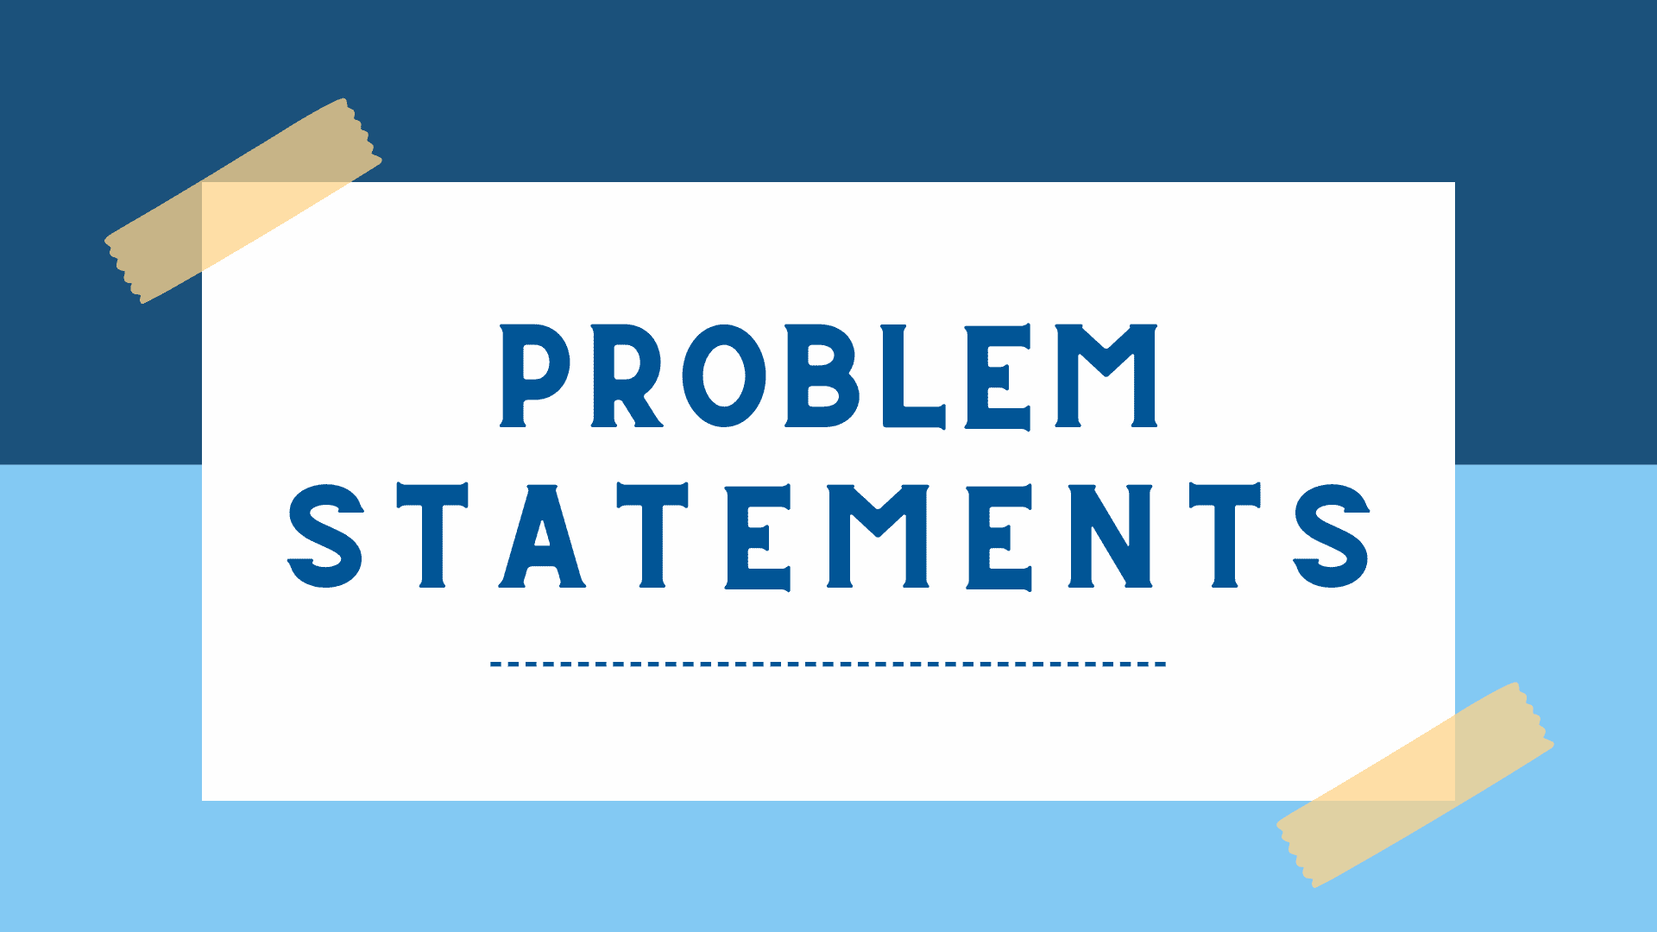
Problem Statement
Health issues like heart disease, diabetes, and obesity are on a rise, and understanding how life choices impact these conditions are more important than ever. This matters as early prediction of health risks is crucial and can help people make better choices and lead healthier lives.
It is commonly known in medicine that prevention is better than cure!
3

Slide 4
Our Approach (Steps)
1.Data cleaning
Data cleaning
Data cleaning
2.Exploratory Data Analysis
Missing values and normalisation of life-related variables.
Exploring relationships between lifestyle factors and health outcomes.
3.Feature Engineering
Data cleaning
Data cleaning
4.Modelling
Aggregate health indices, lifestyle scores and demographic pro.
Logistic regression, k-Nearest Neighbours (kNN), tree-based models and Boosting.
Data cleaning
Data cleaning
5.Evaluation
6.Insights
Use of precision, recall, and ROC-AUC as performance metrics.
Identifying major lifestyle factors and suggesting preventive measures.
4

Slide 5

Machine Learning Models
5

Slide 6
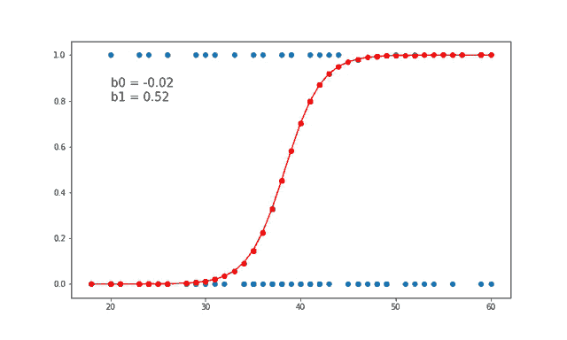
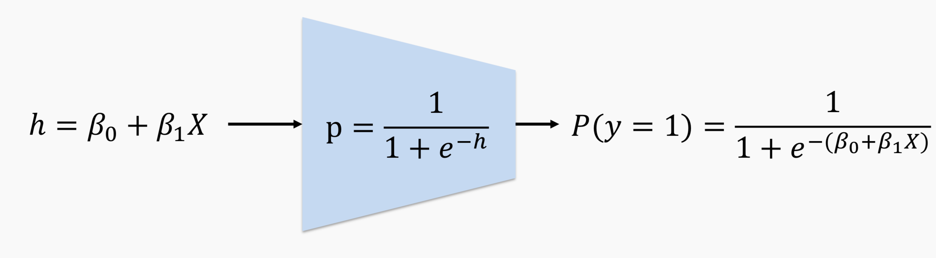
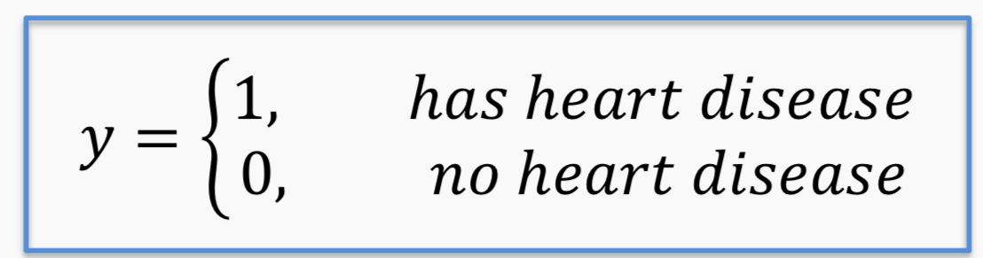
Logistic Regression
Logistic regression is a statistical method used to predict the probability of a binary outcome (like yes/no, 0/1, or true/false) based on one or more input variables. It estimates the relationship between the inputs and the probability of a specific outcome using a special "S-shaped" curve called the sigmoid/logistic function.
Linear regression could be used to predict the probability 𝑃(𝑦 = 1) directly from a set of predictors such as sex, cholesterol levels etc.
If 𝑃(𝑦 = 1) ≥ 0.5, we could predict that the patient has heart disease and predict otherwise if 𝑃(𝑦 = 1) < 0.5.
6

Slide 7
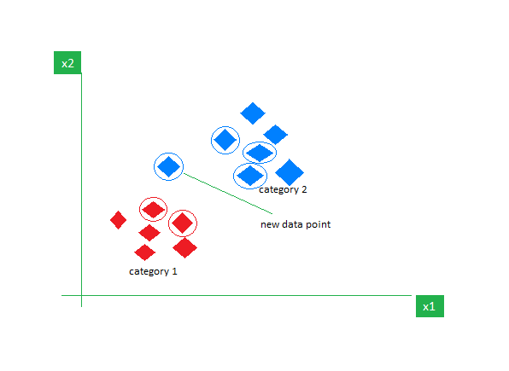
K-Nearest Neighbors (classification)
KNN for classification is a simple algorithm that predicts the class of a data point by looking at the 'k' closest labeled points in the dataset. It assigns the most common class among those neighbors.
Why we used this:
KNN predicts whether a person has heart disease by comparing their health data (like age, cholesterol, and blood pressure) to others in the dataset.
Suppose k = 3, and a new patient’s data is similar to:
2 people with heart disease
1 person without heart disease
KNN will classify this new patient as having heart disease, since the majority of the 3 nearest neighbors do.
7

Slide 8
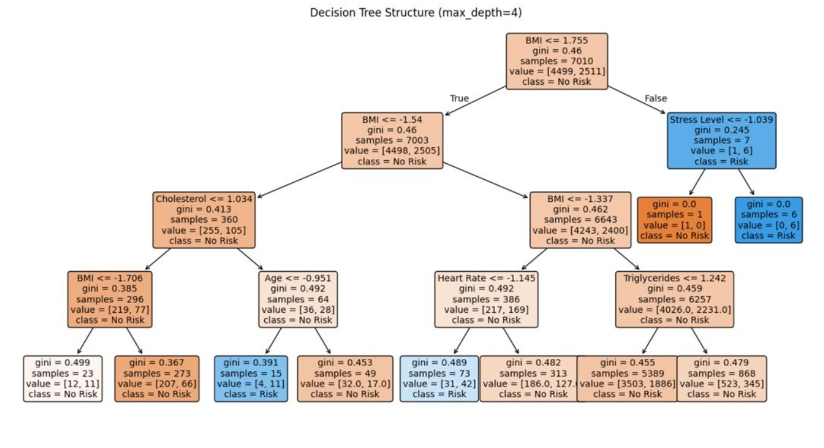
Decision Tree Classifier
Our Decision Tree
A decision tree classifier predicts class labels by splitting data based on features, creating a tree structure. These splits form decision boundaries that separate classes for classification.
Why we used it:
Handles different data types: It works well with both numerical data (e.g., age, cholesterol) and categorical data (e.g., family history).
Provides clear risk categories: By splitting data into groups, it helps identify patients at high or low risk clearly.
No need for much data preprocessing: Decision trees don’t require scaling or normalization.
8

Slide 9
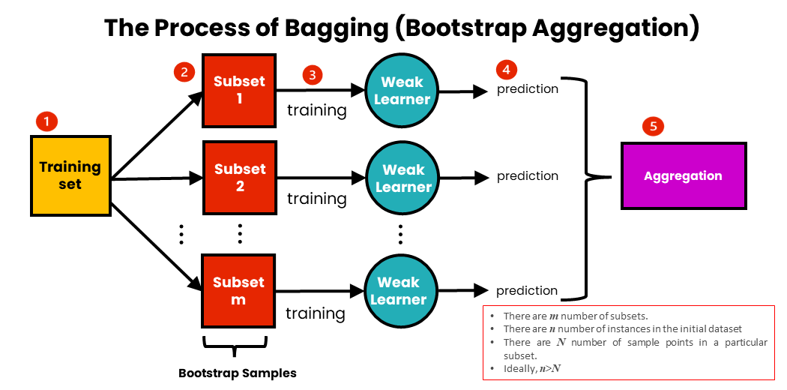
Bagging
Bagging (Bootstrap Aggregating) is an ensemble method where multiple models are trained on different random subsets of the data, created by sampling with replacement. The final prediction is obtained by combining the predictions of all models, typically through averaging or majority voting. Bagging helps reduce variance and improve model stability.
9

Slide 10
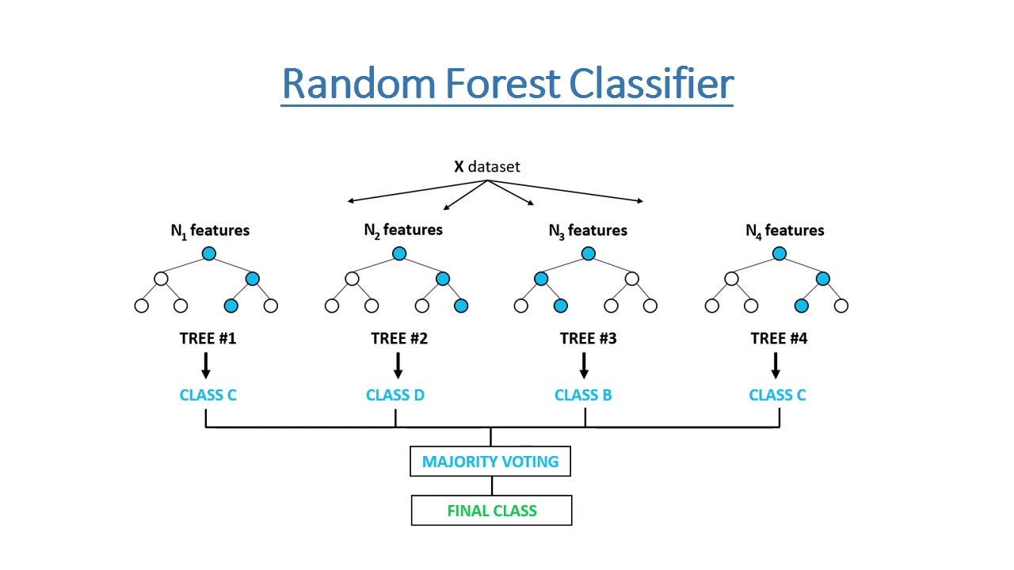
Random Forest Classifier
A Random Forest Classifier is an ensemble learning method for classification that builds multiple decision trees. Each tree is trained on a random subset of the data and features. When making predictions, each tree casts a vote, and the class with the most votes becomes the final prediction. This approach reduces overfitting and improves accuracy compared to a single decision tree.
10

Slide 11
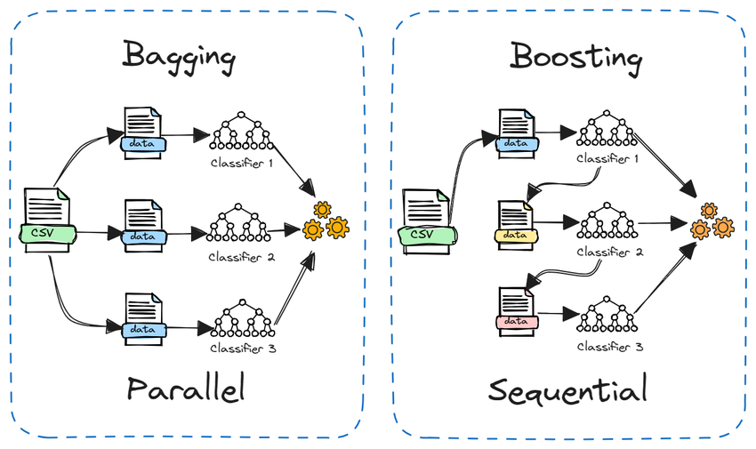
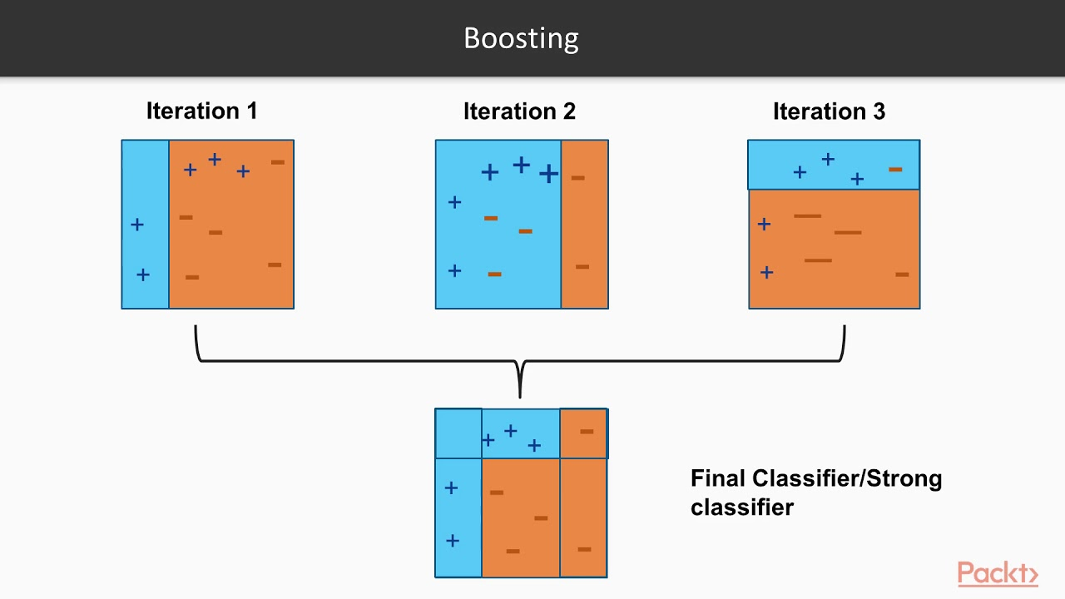
Adaptive Boosting (AdaBoost)
AdaBoost is an ensemble method that combines multiple weak classifiers, usually decision stumps, to improve performance. For predicting heart disease, decision stumps are trained on features like age, cholesterol, and blood pressure. It adjusts the weights of misclassified instances in each iteration to reduce errors.
11

Slide 12
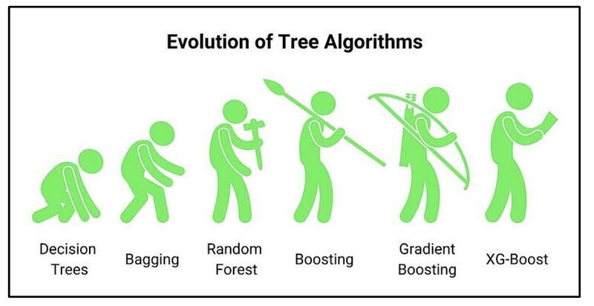

XGBoost
XGBoost is an efficient gradient boosting decision that builds decision trees sequentially, where each tree corrects the errors of the previous one. XGBoost improves performance with features like regularization (to prevent overfitting), parallel processing (for faster training), and handling missing data.
Conversely to AdaBoost, XGBoost builds full decision trees rather than decision stumps (single-level decision trees).
12

Slide 13

Results and Metrics
13

Slide 14
The metrics
Accuracy – % of correct predictions
Precision – How many predicted positives are correct
Recall – How many actual positives are found
F1 Score – Balance between precision and recall
Confusion Matrix – Detailed breakdown of prediction results
ROC AUC – Measures how well a classification model distinguishes between classes
14

Slide 15
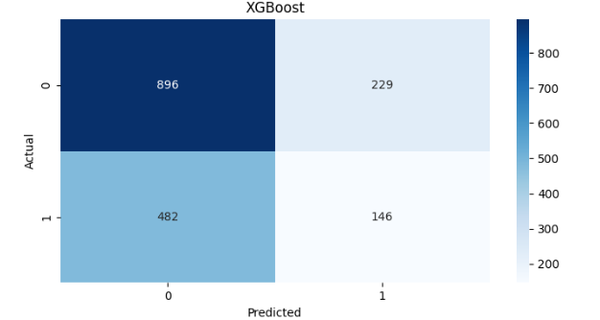
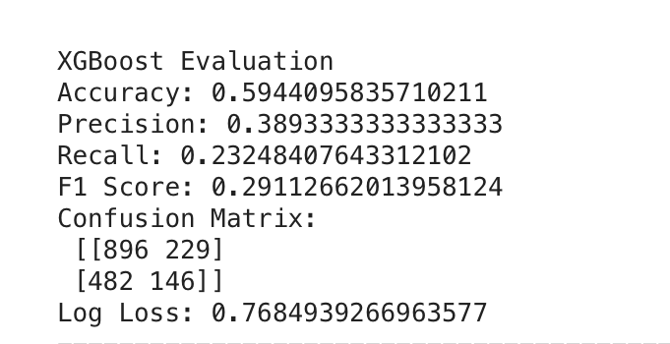
Best Model: XGBoost
Overall, the best model was XGBoost with a relatively high accuracy of 0.59. However, there were other models with higher accuracy such as bagging (0.62) and the Decision Tree (0.62). The reason we viewed this as the best model was due to its completeness of having both a decent recall (0.23) and the highest precision (0.39) which lead it having a good F1 score of 0.3 in comparison to our other models. Lastly, it handled complex patters better than other models and had one of the lowest log loss.
15

Slide 16
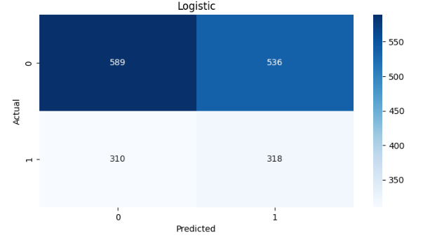
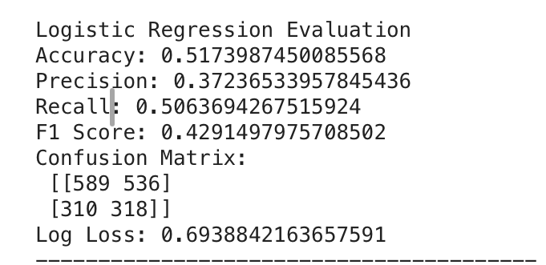
The Model that surprised us: Logistic Regression
The simple model of Logistic Regression surprised us with it having the highest recall of 0.5 leading to the highest F1 score of 0.42, this is vital for our project as we.re predicting heart disease and finding who is under risk is vital, no matter the false positives. However, we didn’t portray this as our best model as it had a low accuracy of 0.52.
16

Slide 17
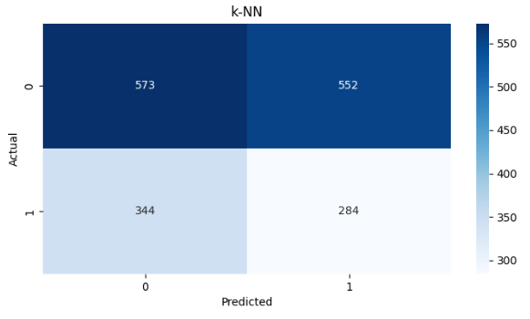
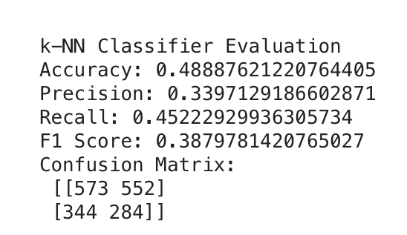
Worst Model: KNN
Unsurprisingly, the worst model was KNN with the lowest accuracy of 0.49. In addition to that, its performance was the lowest for precision (0.34) and somewhat good for recall (0.45) meaning a 0.39 for F1 score. Lastly, it had the most false alarms which isn’t ideal for predicting heart disease.
17

Slide 18
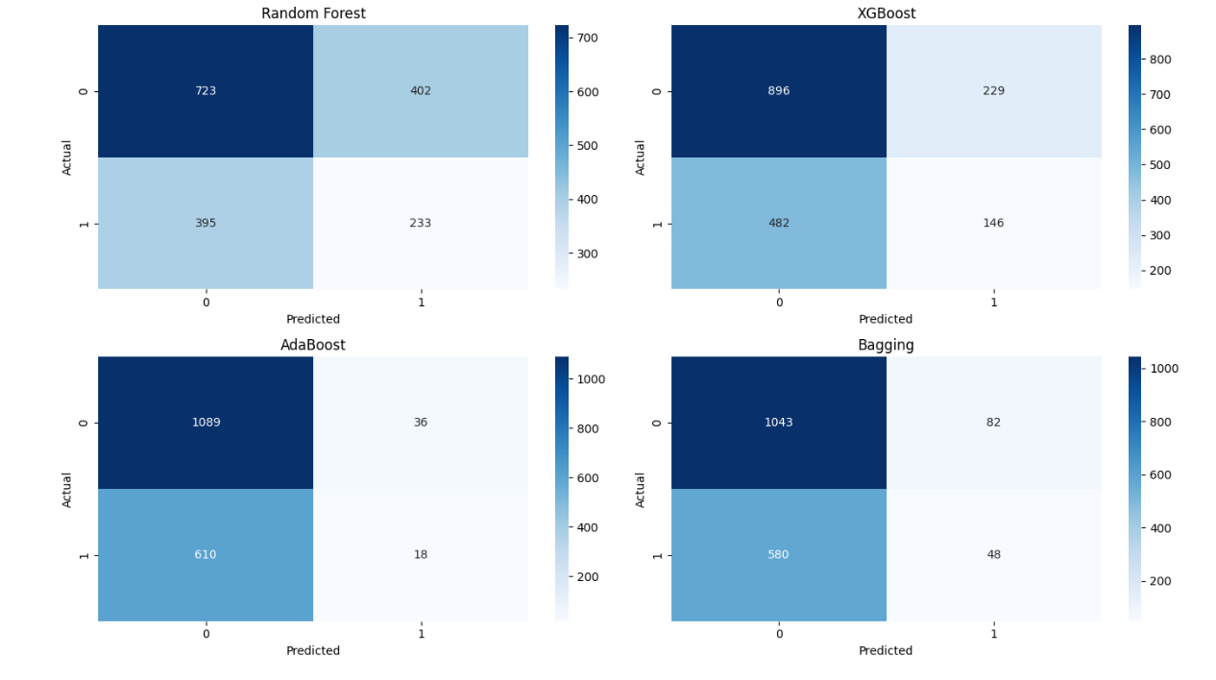
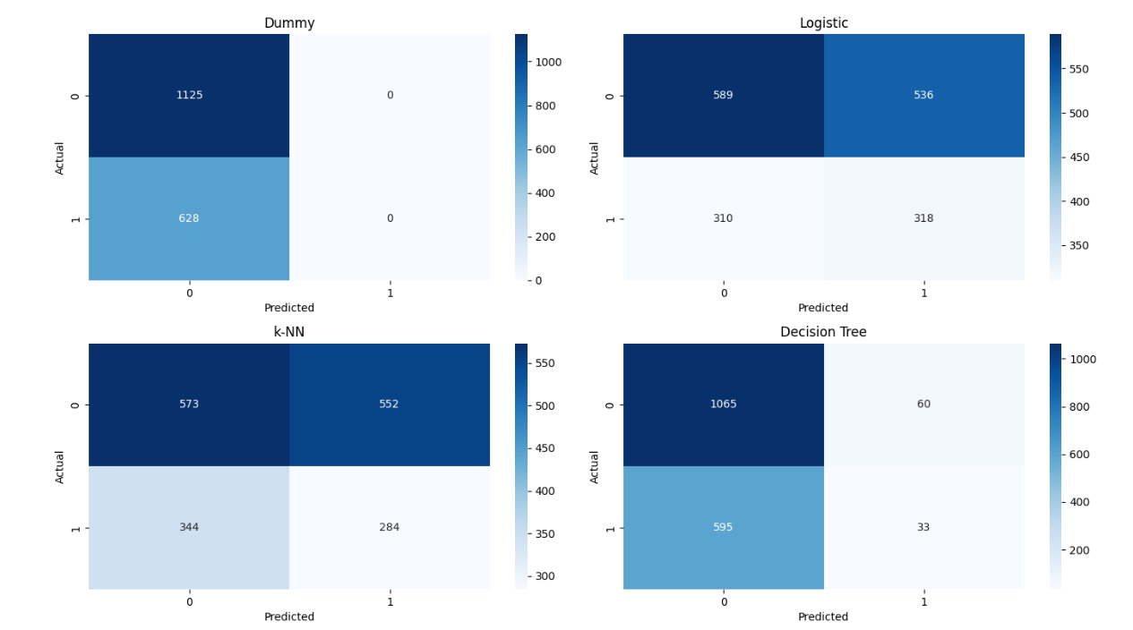
Confusion Matrices
18

Slide 19
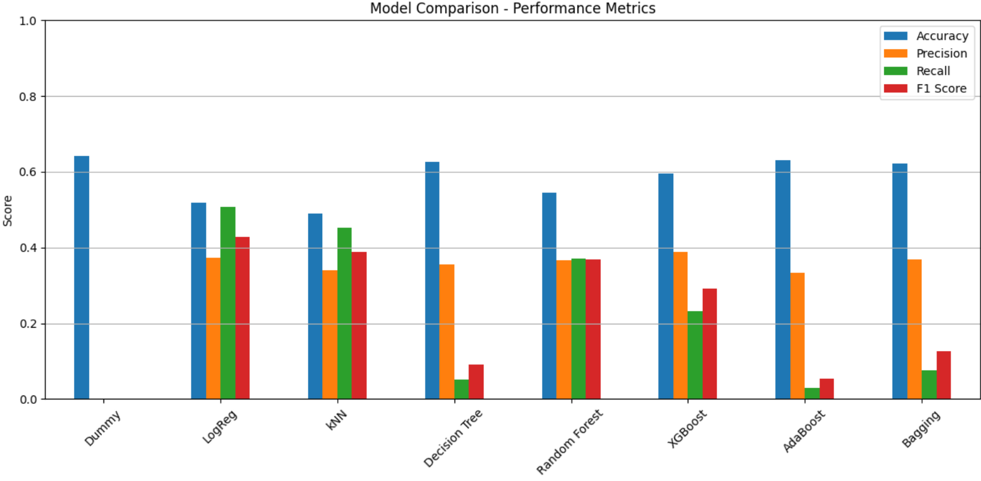
Model Comparison – Performance Metrics
Comparison of all machine learning models’ evaluations using accuracy, F1 score, precision and recall in a grouped bar chart.
19

Slide 20
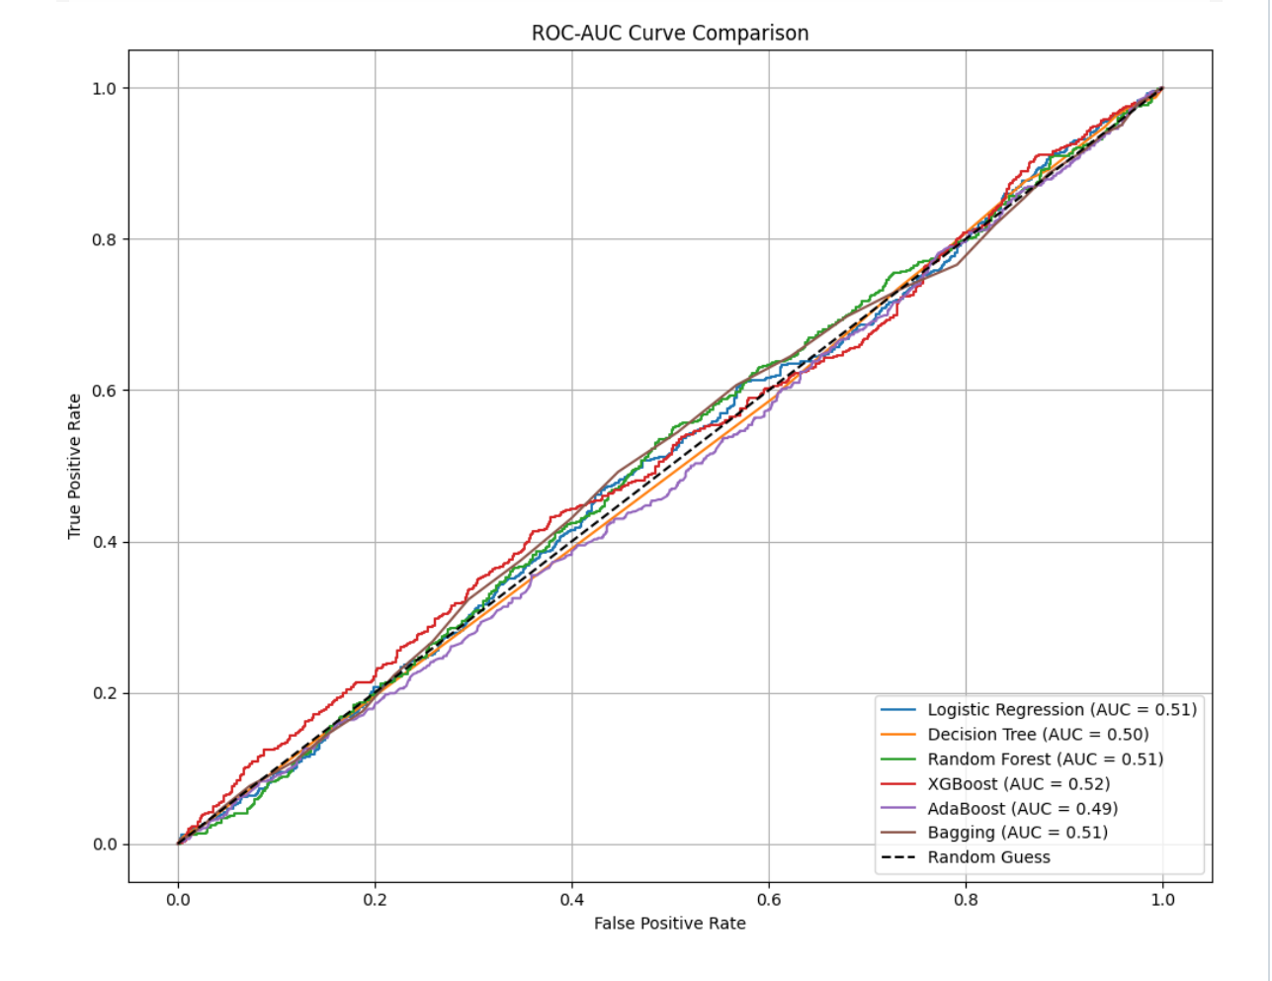
ROC AUC Curve
20

Slide 21
What went well
Utilized GridSearchCV which tuned the hyper-parameters to reach out to the best set of them meaning best performance for the models.
Included a variety of models (in total 8), which really tested our knowledge throughout the course.
Used every metric we learned for each model creating a good viewpoint for each model, also used similar metrics to compare each model easily.
Use of SMOTE to oversample the minority class and reduce class imbalance.
21

Slide 22


How we could improve our solution in the future!
Use of a larger sampling size/dataset, we obviously didn’t do this for the long runtime.
Divert from solely predicting heart disease into other diseases such as diabetes, pulmonary and neural diseases. (We’re planning to do this in the future).
Use other approaches of oversampling (random sampling), undersampling (random sampling and Near Miss) or class weighting instead of SMOTE.
Focusing on less but better models (Boosting and Random Forest) to find the best hyper-parameters and leading to best model evaluation (higher accuracy, better F1 score and good ROC AUC curve).
22

Slide 23

Thank you for your attention!
23

